Slide 1
Air Quality Forecast Modeling
Pius Lee
NOAA/Air Resources Laboratory
June 22, 2016
Team: Daniel Tong, Hyuncheol Kim, Li Pan, Youhua Tang, Rick Saylor,
Min Huang and Barry Baker

Slide 2
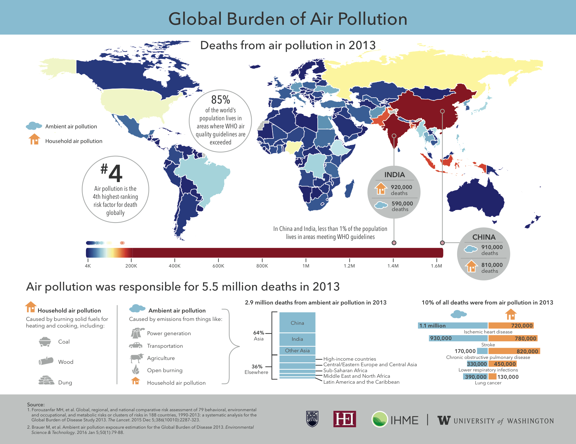
: 5,500,000
85% of world’s population lives in areas where WHO air quality guidelines are exceed
#4 Air pollution is the 4th highest risk factor for death globally
Notes:
In 2013 alone, five and a half million people died due to air pollution. The color codes for each country depict the annual casualties. World-wide, air pollution is the number four cause of premature death. In terms of exposure, 85% of the world’s population live in areas not meeting the World Health Organization’s air quality guideline for healthy air.

Slide 3
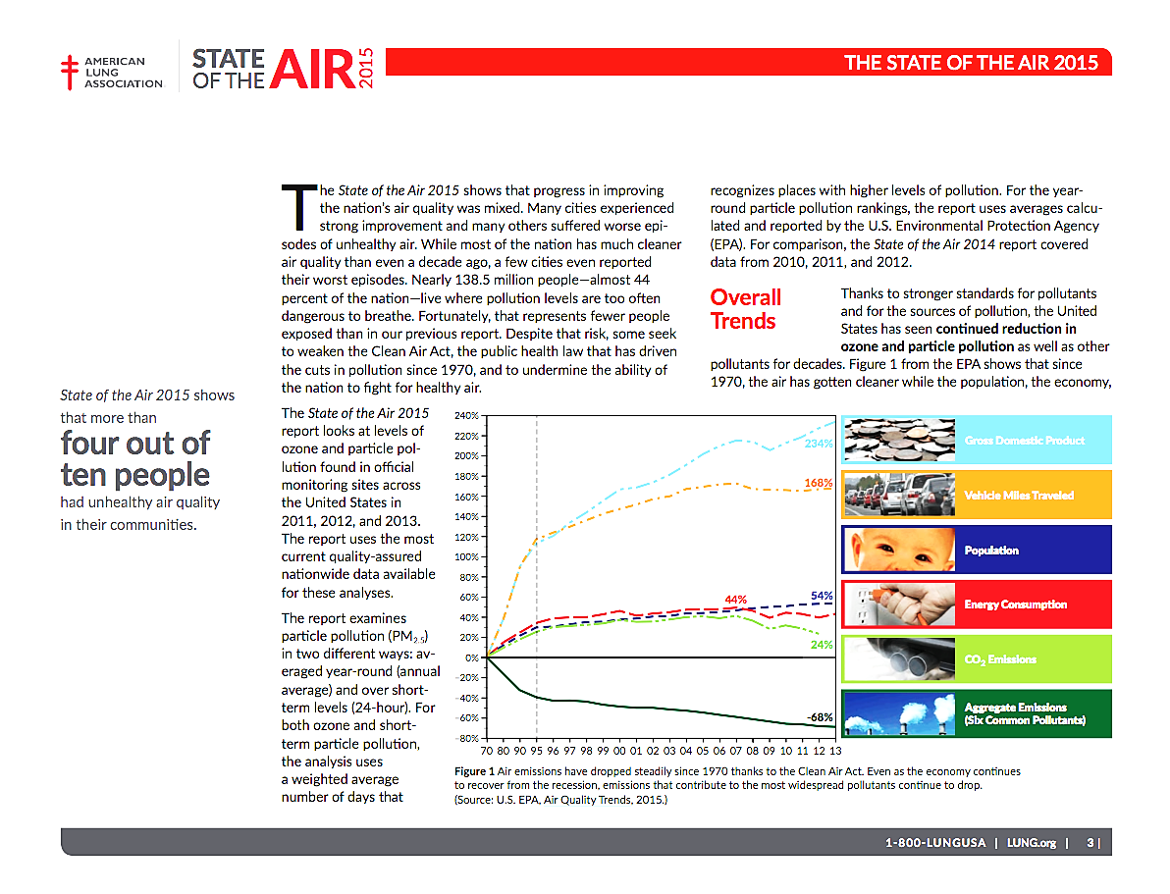
Relevance:
U. S. air quality has improved dramatically, but 138.5 M people still live in areas where “pollution levels are too often dangerous to breathe.”
Notes:
In the last four decades, considering the doubling of GDP and vehicle miles travelled, the pollutant emission rate had not grown proportionally. The bottom dark-green line showed a decrease of 68%
in the lumped emission amount accounting for CO, PM2.5, elemental Carbon, SOx, NOx and ozone. However, in terms of health impact much the American urban dwellers are inhaling unhealthy air.
This report from an American Lung association affiliated study between 2011-2013 showed that 44% of Americans are inhaling unhealthy air regularly.

Slide 4
Mandates:
Air Quality Forecast Modeling
NOAA’s Five-Year (2013-2017) Research & Development Plan
  Weather-Ready Nation
  Healthy people and communities due to improved air and water quality services
  Science and Technology
  A holistic understanding of the Earth system through research
  Accurate and reliable data from sustained and integrated Earth observing systems
  An integrated environmental modeling systems

Slide 5
Air Quality Forecast Modeling
  Supporting and improving NOAA’s National Air Quality Forecasting Capability (NAQFC)
  Support of field measurement campaigns (DISCOVER-AQ, SOAS)
  Chemical Reanalysis
Notes:
Three products and three expertise areas leveraging with one another for mutual and collective benefits.

Slide 6
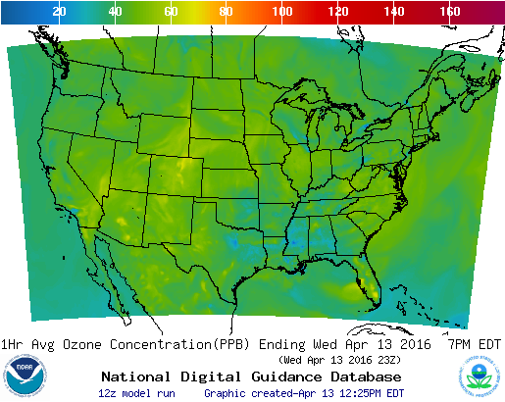
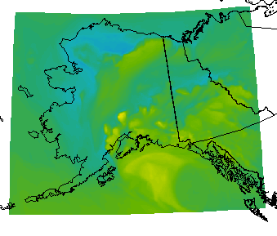
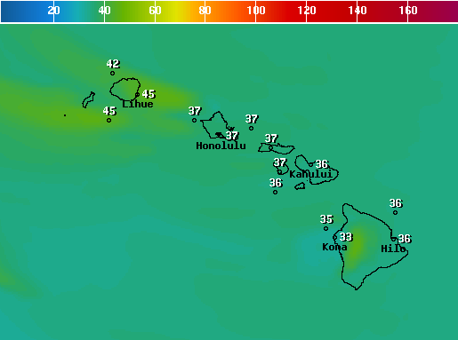
National Air Quality Forecast Capability (NAQFC) for O₃ and PM_{2.5}
Meteorological Model
North American Model (NAM) - 12 km
Emission projection
Area sources use US EPA 2011 NEI v1
Point sources use biennial CEM and latest DoE energy consumption outlook
Mobile sources use US EPA 2012 Cross State Air Pollution Rule MOBILE6 output scaled by EPA AQS monitored trends
BEIS3 v3.14 Biogenic Emissions
Intermittent sources: dust and wildfire
Air Quality chemistry-transport Model
US EPA CMAQ v4.6 – 12 km
NAQFC 48 h forecast online:
O₃ for CONUS, AK and HI
PM_{2.5} for CONUS
Surface O₃ concentration in ppb
Alaska
Hawaii
airquality.weather.gov
Notes:
The NOAA National Weather Service (NWS) National Air Quality Forecast Capability (NAQFC) is a modeling system designed to provide air quality forecast guidance for the U. S. The NAQFC was established in 2004 to provide ground-level ozone (and eventually PM_{2.5}) forecasts for the conterminous U. S. (CONUS). The NAQFC utilizes the NWS North American Mesoscale (NAM) meteorological model run of the Non-hydrostatic Mesoscale Model (NMM) core to provide forecast meteorological fields. These data drive the U. S. Environmental Protection Agency (U.S. EPA) Community Multiscale Air Quality (CMAQ) version 4.6 modeling system which produces 48-hr forecast fields of ground-layer ozone and PM2.5 mixing ratios. The CMAQ portion of the NAQFC system uses 12 km horizontal grid spacing and 35 vertical layers from the surface to 100 hPa. Emissions inputs to CMAQ use the latest available U.S. EPA National Emissions Inventory (NEI) with electric generating units (EGUs) updated with Continuous Emission Monitoring (CEM) data and projections to the current forecast year using data from the Department of Energy’s Annual Energy Outlook.

Slide 7
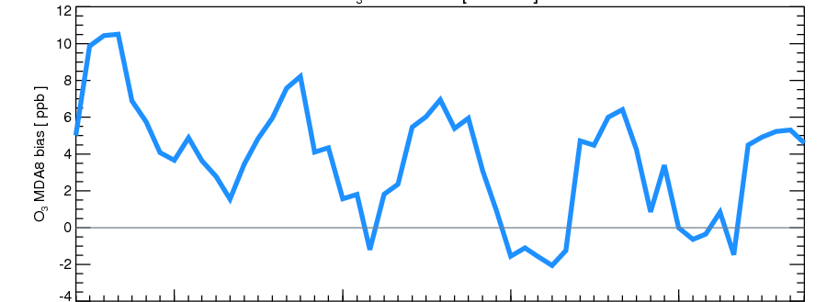
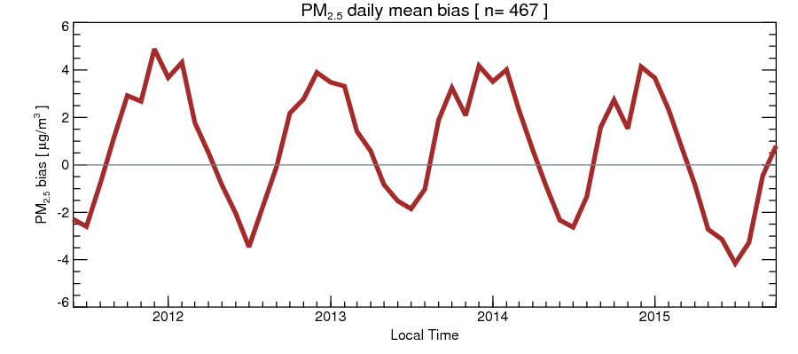
Forecast Bias for ozone and PM_{2.5}
Reduction of O3 summer time high bias
Bias (ppb)
MDA8 O₃ performance
PM_{2.5} (μg m⁻³)
PM_{2.5} performance
Notes:
Since the last ARL Lab review in 2011, there has been significant improvement in the accuracy of the ozone forecast. In particular, the over-estimations in most of the year especially in the late summer months were significantly reduced. For instance, in July 2011, the daily maximum 8 h average ozone averaged over the CONUS was around 11 ppbv. The counterpart value for 2015 was around 4.5 ppbv. For PM2.5, the trend of gradual improvement in forecasting accuracy was not obvious.

Slide 8
Relevance: NAQFC upgrades
TRL9
Changes imposed by others:
- NAM change 10/2011: Changed from WRF-NMM (e-grid) to NMMB (b-grid),
meteorological field preparation for CMAQ was adapted
- Major NCEP computer upgrade 9/1/2013: Changed operational computer
and operational system
Changes imposed by ourselves pursuing proven implementable science:
- Reduction of NOx 6/1/2012: Mobile sources used US EPA 2012 Cross State Air
Pollution Rule (CSAPR) MOBILE6 output scaled by EPA AQS monitored trends
- CB05 and developmental PM_{2.5} 1/29/2015: CB05 and AERO4 were used to
provide gas and aerosol compositions; Intermittent sources for wildfire and
windblown dust were included; Sea salt emissions were included
- U.S EPA 2011National Emissions Inventory (NEI) 5/1/2015
- Operational PM_{2.5} 2/9/2016: Model layers increased by 60% mostly in the upper
levels; Linkage w/ NCEP’s operational aerosol model via dynamic boundary
conditions
Notes:
The upgrades performed to NAQFC over the past 5 years could be categorized by subject areas. However, one common tread linking them together is that NAQFC objectives and upgrades are dynamic. Some were imposed on NAQFC by upstream processes such as NAM change, and some were pursued due to obvious potential for improvement for forecasting accuracy.

Slide 9
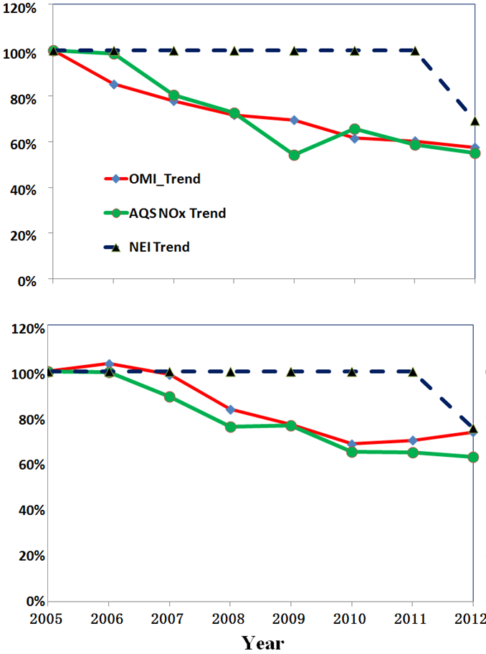
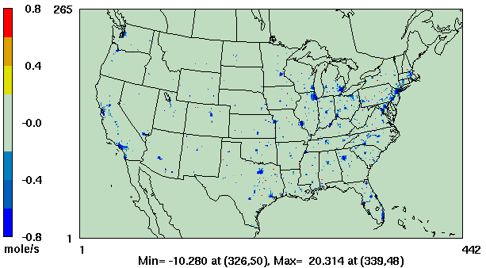
NOx Emissions
Comparison to 2005 values
TRL9
Atlanta
OMI NO₂
ASQ NO_{X}
NAQFC NO_{X} Emissions
Comparison to 2005 values
Philadelphia
Relying on projections rather than inventories for mobile sources
Comparison of projected emissions with surface and satellite observations
OMI = Ozone monitoring Instrument on
NASA’s Aura Satellite
AQS = Air Quality System
Talk this morning by Daniel Tong:
“Emissions Modeling”
Notes:
The left panel shows two of the many cities we studied to adjust NOx emission inventory released by the U.S. EPA. All values are spatially averaged for urban centers. Temporally, all values were monthly averages and for AQS and NAQFC they were averaged between 6:00-9:00am local hours, and OMI is taken for its daytime overpass value.

Slide 10
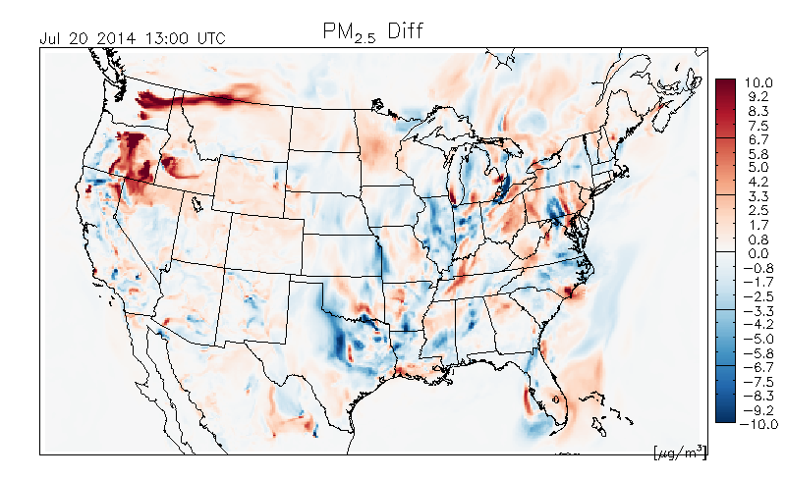
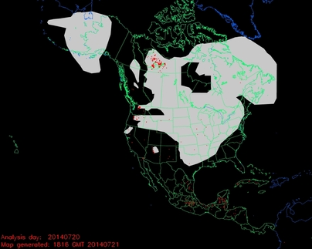
Impact of forest fires in
testing of PM2.5 predictions
TRL9
Difference between two PM2.5 predictions:
with-minus-without fire emissions
NOAA NESDIS Hazard Mapping System Fire and Smoke Analysis
Notes:
The right panel shows a movie of contrast between a dust storm case where such intermittent sources was captured “with” wind-blown dust parameterization (dubbed “with”) subtracting from the same case where parameterization was not accounted for “without” (dubbed “without”). The left column depicted a daily NESIDS Hazard Mapping System report for the same day – July 20 2014.

Slide 11
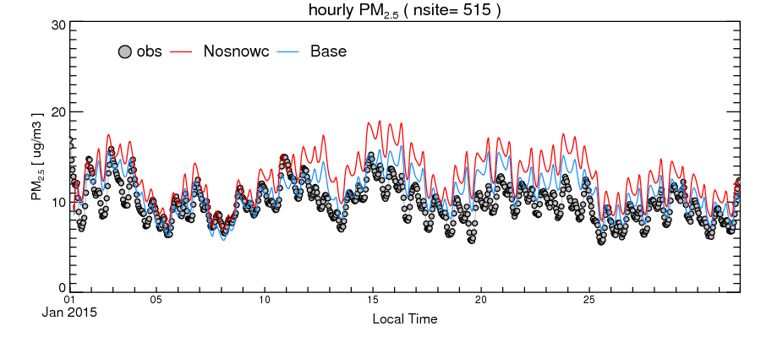
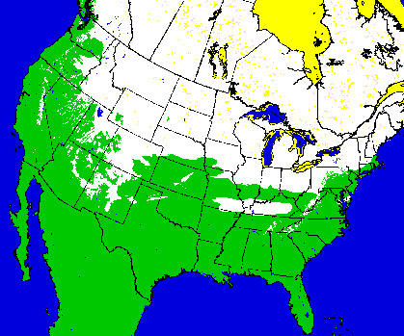
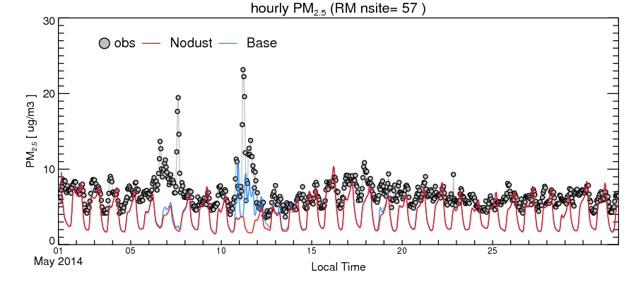
Suppression emission of fugitive dust over
Ice/snow
in Jan 2015
Implemented 2016/02
PM_{2.5} (μg m⁻³)
TRL9
Account for wind blown dust sources
in May 2014
Implemented 2016/02
PM_{2.5} (μg m⁻³)
TRL9
Notes:
Wind blown dust is naturally suppressed by snow/ice cover. The top panel showed that the suppression option helped the January 2015 forecast accuracy dramatically. On the averaged a 52% reduction in over-estimation was achieved.
The bottom panel showed that a dust storm happened on the evening of May 11 2014. The spike in surface concentration for PM2.5 was obvious noted by the measurement (open circles) compared to a severe underestimation by the simulation without windblown dust parameterization (red line) and the significant improved simulation results accounting windblown dust emissions due to the Owen’s Equation (blue line).

Slide 12
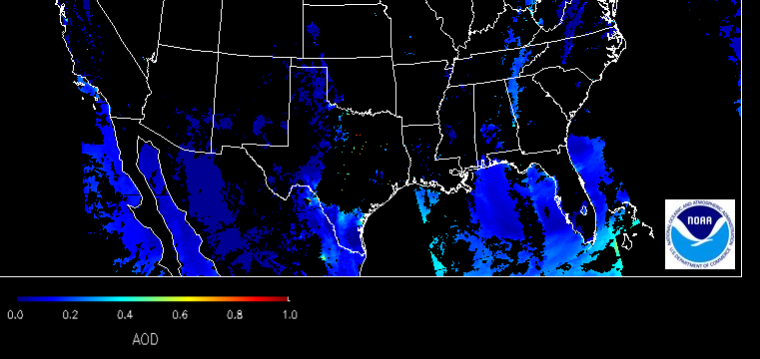
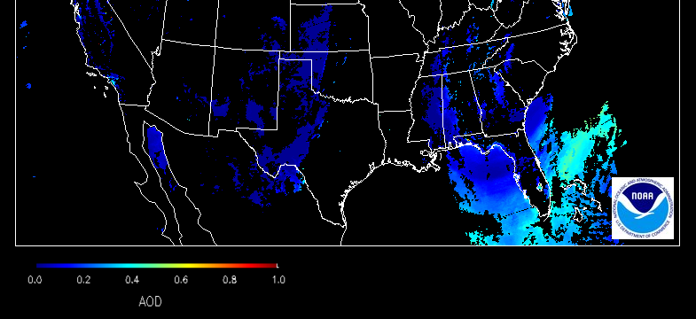
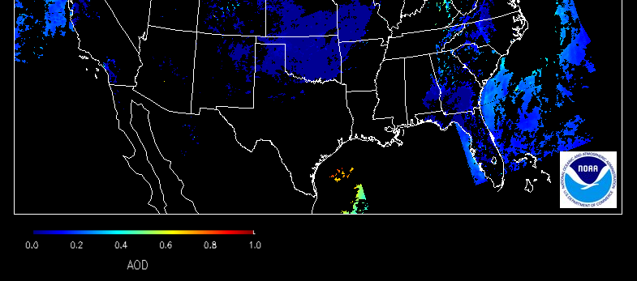
A Recent Sahara Dust Intrusion
Sahara dust event May 9-11 2015
VIIRS AOD
Courtesy: Shobha Kondragunta
(NESDIS)
12 UTC May 9
12 UTC May 10
12 UTC May 11
Notes:
An Saharan dust intrusion event occurred between May 9-11 2015 was recorded by imageries compiled by the VIIRS instrument on board of JPSS-1. The blue swaths on the imageries reflects the aerosol optical depth in accordance with the color scale shown in the lower left corner color bars.

Slide 13
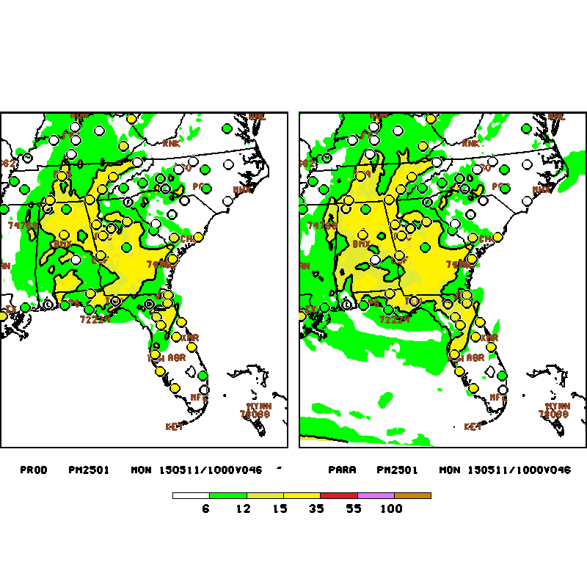
Surface concentration of PM_{2.5} at 10 UTC May 11 2015: modeled (background shading),
measured (filled circle)
Without dynamic boundary condition With dynamic boundary condition
TRL9
PM_{2.5} in µg m⁻³
Notes:
The same Saharan dust intrusion case shown in the previous slide impact a large swath in southern FL. The background shading represents NAQFC predicted surface concentration of PM2.5 where the filled circle represents measured value by the AIRNow surface network. Both sets of values are depicted in accordance with the color bar in the bottom of the plots.

Slide 14
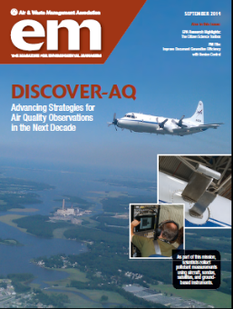
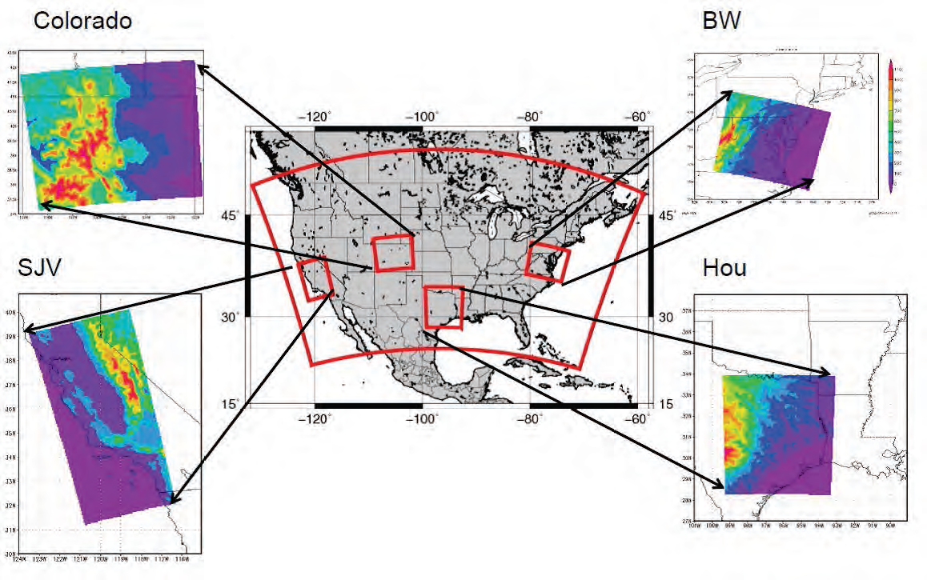
Relevance: Campaign Collaboration AQ Forecasting
4 DISCOVER-AQ Campaigns
Pickering and Lee, EM 2014;
Garner, Thompson & Lee Atm Chem 2013
Notes:
Engagement in the DISCOVER-AQ (Deriving Information and Surface Conditions from VErtically Resolved measurements relevant to Air Quality) field campaigns benefited NAQFC considerably in terms of access to campaign data and daily discussions during the campaigns.

Slide 15
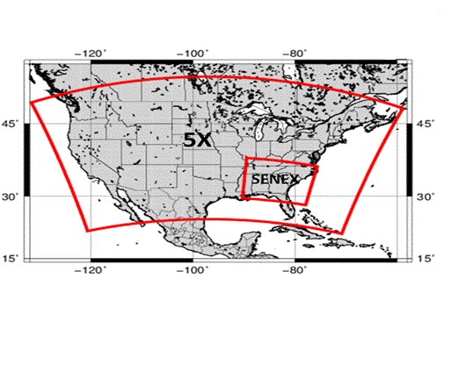
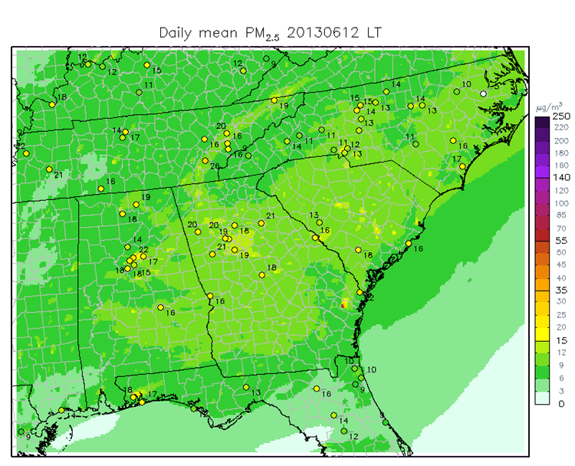
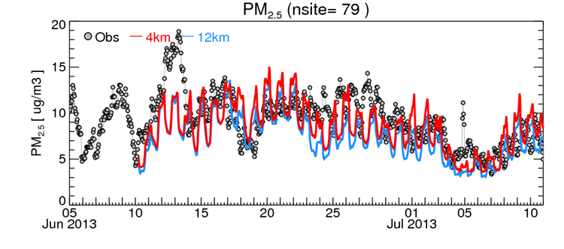
Relevance: Campaign Collaboration AQ Forecasting
NOAA’s Southern Oxidant and
Aerosol Study (SOAS) - June-July 2013
4 km domain nested within the 12 km NAQFC
Talk this morning by Rick Saylor:
“Surface-Atmospheric Exchange Modeling”
Notes:
The NOAA SOAS (Southern Oxidant and Aerosol Study) was an important study. Besides concentrations, the study also focused on processes. DDM, the CMAQ Direct Decoupled Method, is a brute force utility within CMAQ designed to analyze processes. The DDM can be employed to examine the highly temporally resolved chemical compositional data from the campaign.

Slide 16
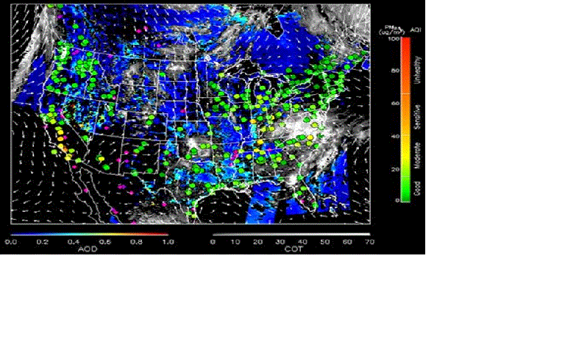
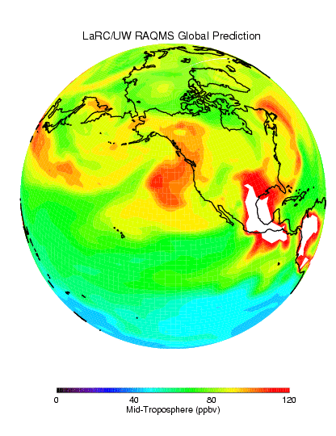
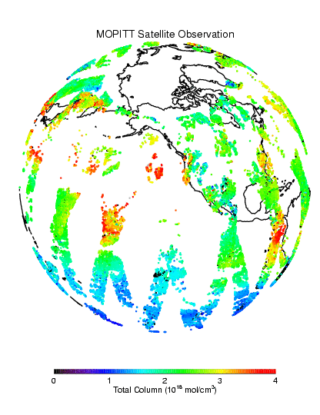
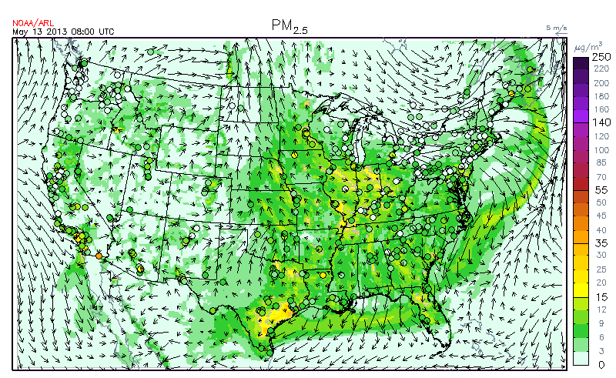

FY 2013 – 2015 : AQAST Tiger Team: Air Quality Reanalysis
(Translating Research to Services)
+ AQ Assessments
+ State Implementation Plan Modeling
+ Rapid deployment of on-demand rapid-response forecasting; e.g., new fuel type,…, etc.
+ Health Impacts assessments
+ Demonstration of the impact of observations on AQ distributions
+ Ingestion of new AQAST products into operations
Global
Assimilation
Satellite
Products
Constrained
http://acmg.seas.harvard.edu/aqast/projects.html
2011-2016
Notes:
Objective: Best estimated state of the chemical composition of the atmosphere (lower troposphere)
A sizeable user group: AQ application as well as health epidemiology scenarios
A ‘reanalysis’ is a climate or weather model simulation of the past that includes data assimilation of historical observations. The observations can be very comprehensive (satellite, in situ, multiple variables) or relatively sparse (say, sea level pressure only), and the models themselves are quite varied. Generally these models are drawn from the weather forecasting community (at least for the atmospheric components) which explains the odd terminology. An ‘analysis’ from a weather forecasting model is the 6 hour (say) forecast from the time of observations. Weather forecasting groups realized a decade or so ago that the time series of their weather forecasts (the analyses) could not be used to track long term changes because their models had been updated many times over the decades. Thus the idea arose to ‘re-analyze’ the historical observations with a single consistent model. These sets of 6 hour forecasts using the data available at each point are then more consistent in time (and presumably more accurate) that the original analyses were.

Slide 17

12z July 2 2011 forecast valid for 18z on same day: NAQFC setup
Color-shading for
Surface PM_{2.5} (μg m⁻³)
Color bar for bias
w.r.t. AIRNow (μg m⁻³)
Same as a) but with data assimilation adjusted Initialization
Large reduction in
underestimation of PM2.5 w.r.t.
Tang et al., 2015: Using optimal interpolation to assimilate surface
measurements and satellite AOD for ozone and PM2.5:
A case study for July 2011, JAWMA, 65, 1206-1216
Notes:
For chemical data assimilation, across the board improvement was achieved when quality assured data were assimilated frequently.

Slide 18
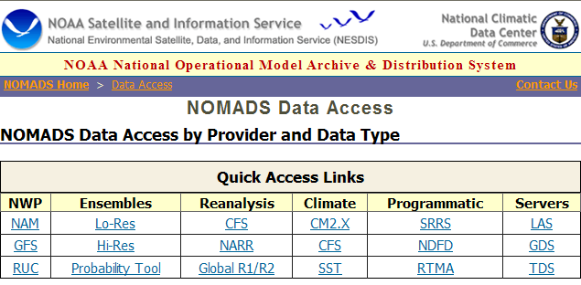
Relevance
Chemical Analyses: User Friendly and downloadable
As reanalysis meteorological fields for NWP community
Chemical reanalysis fields for atmospheric modelers and epidemiologists
Notes:
User Friendly interface now available. Large data set will be constantly available. We are in the process of building a portal at ARL similar to the NCEP NOMADS since it has high user satisfaction, is easy to navigate, and has reliable access.

Slide 19
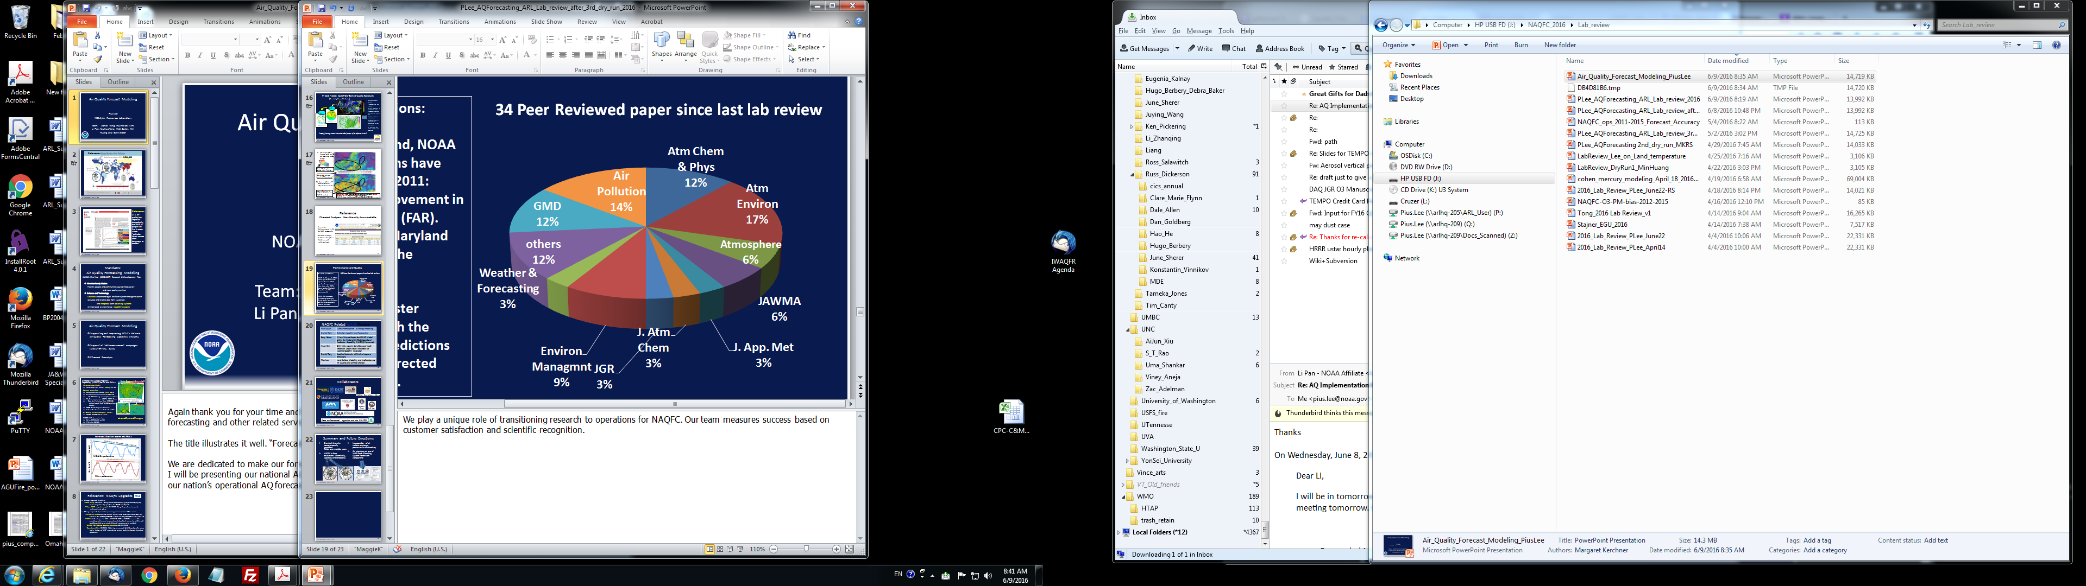
Performance and Quality
Selected quotations:
2012: In Maryland, NOAA ozone predictions have improved since 2011: significant improvement in false alarm ratio (FAR). (Laura Landry, Maryland Department of the Environment)
2015: PA forecaster recommend both the direct model predictions and the bias corrected PM2.5 forecasts.
Notes:
We play a unique role in transitioning research to operations for NAQFC. Our team measures success both basing on forecast performance: timeliness and accuracy as well as scientific recognition.

Slide 20
NAQFC Related Talks & Posters
Rick Saylor | Surface-atmosphere exchange modeling
Daniel Tong | Emissions Modeling
Barry Baker | A New Way to Couple the CMAQ Model Using the National Unified Operational Prediction Capability (NUOPC) Framework
Hyun Kim | OMI NO₂ column densities over North American urban cities: The effect of satellite footprint resolution
Daniel Tong | Satellite Retrievals of Marine Emissions
Pius Lee | Land Surface Modeling and Implications to Air Quality and Climate Change
Notes:
TALK: to follow are two NAQFC talks on two most influential processes of AQ forecasting.
POSTER . Cordially be invited to visit our afternoon poster session.

Slide 21


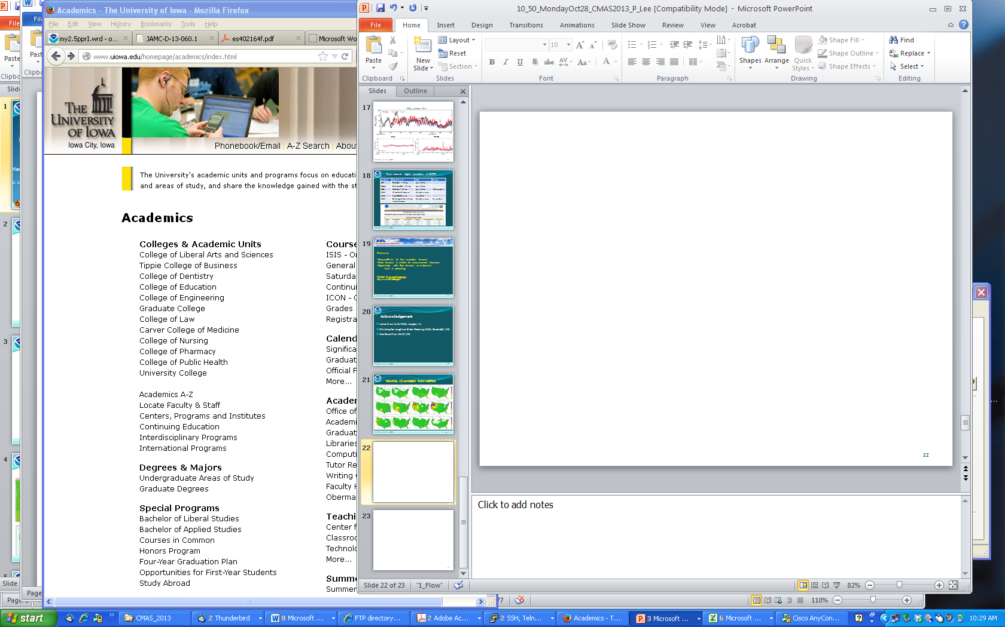


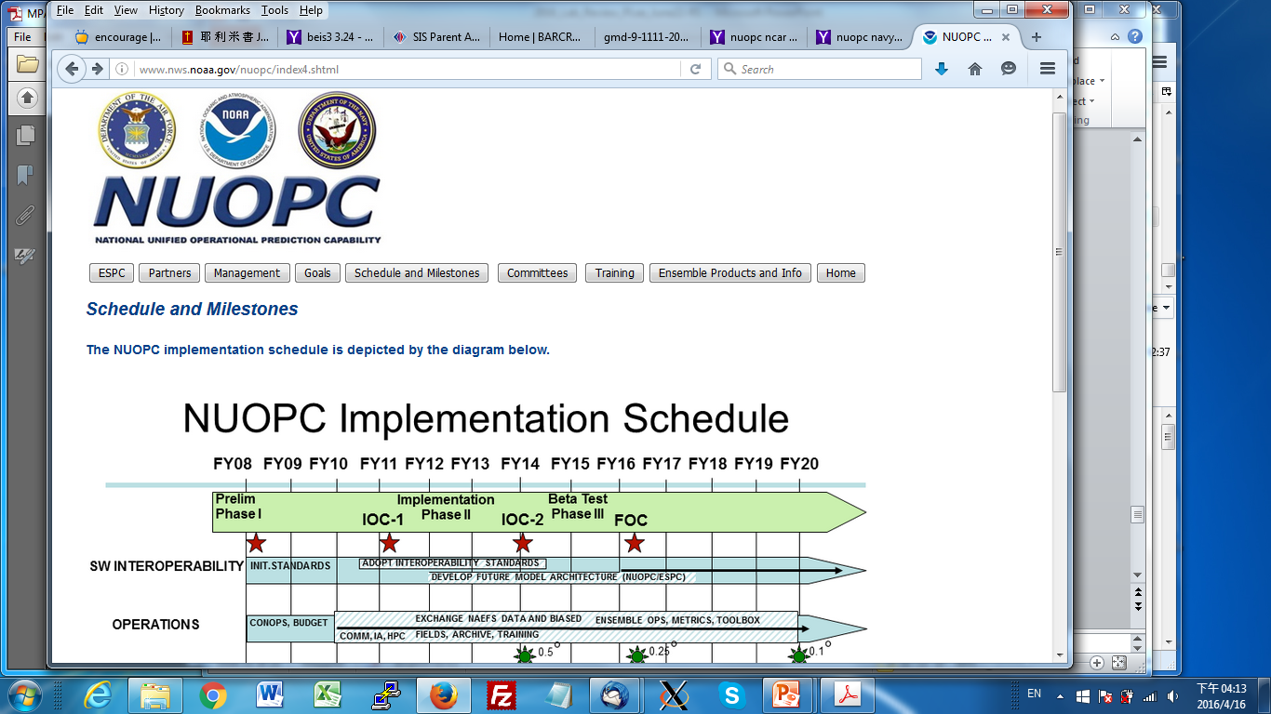

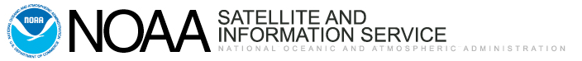
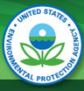
Collaborators
NASA Air Quality Applied Science
U.S. Air
Force
U.S. Navy
State environmental agencies and the U.S. EPA
Notes:
Many affiliations and collaborators – both academia and government institution communities.

Slide 22
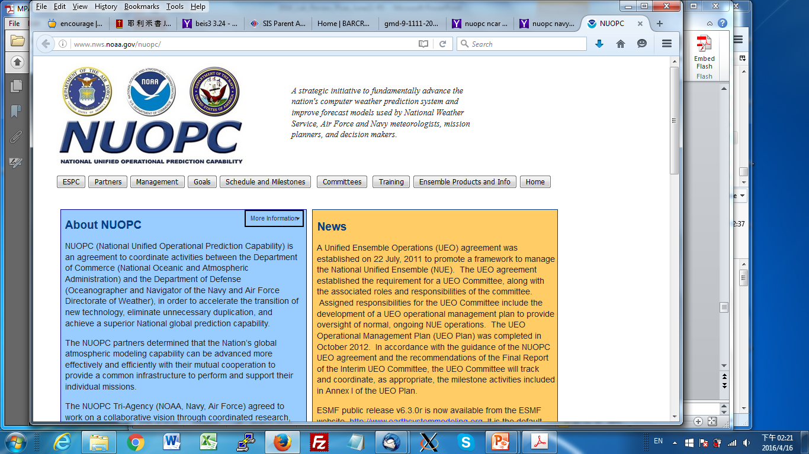
Summary and Future Directions
Chemical Analysis: homogeneously generated
fields over multiple years
NAQFC in finer resolutions: chemically,
spatially and temporally
Incorporation of air-surface exchange processes in air chemistry
Air chemistry as one of NCEP Earth Modeling System Framework components
example
example
example

